Slide 1
Open Data Open Source
A biased view from Vivian Balakrishnan

Slide 2

Lessons learnt the hard way

Slide 3
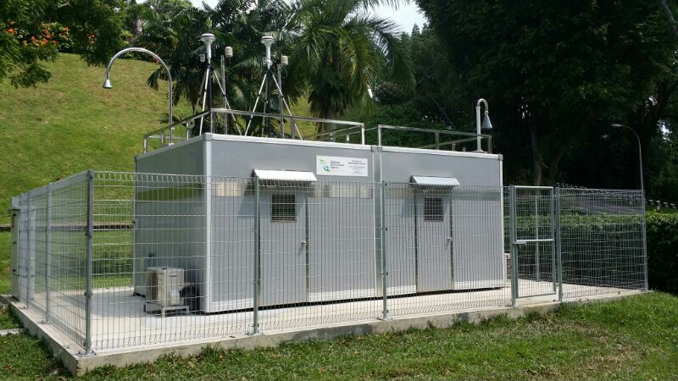
Air quality sensors

Slide 4
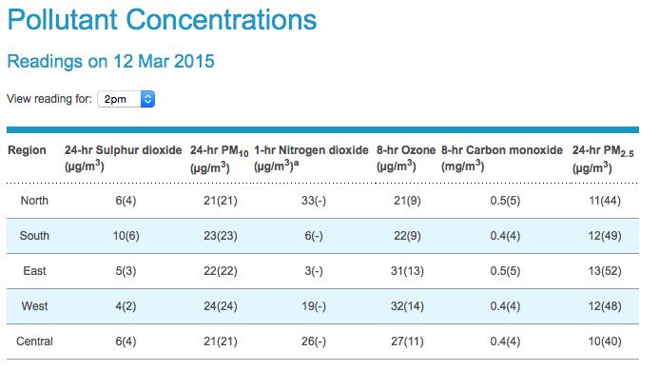
Real time monitoring

Slide 5
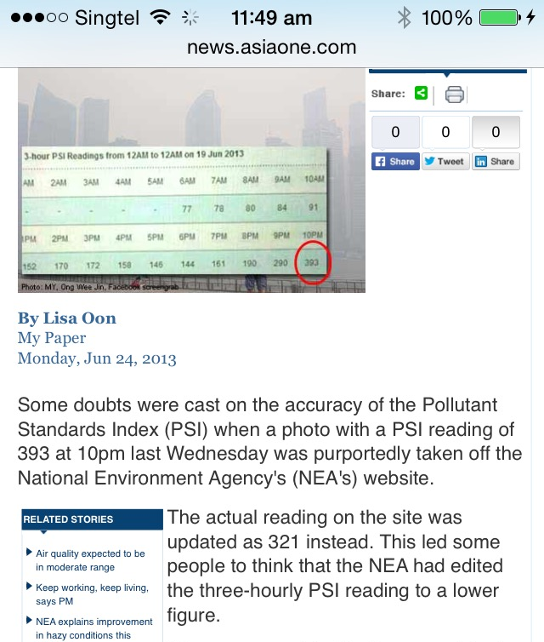
DRUMS

Slide 6
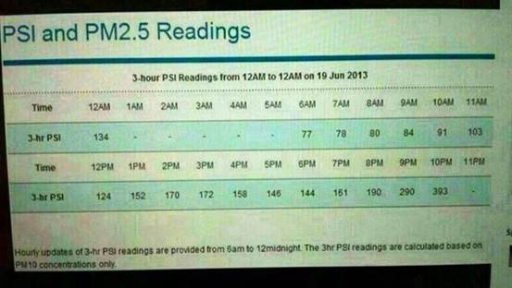
DRUMS

Slide 7
Credibility & Trust
Transparency
Real time
Verifiability

Slide 8
Data.gov.sg
Central repository of government datasets
118 environment datasets are machine readable
CSV
Txt
Excel
KML
Access through APIs

Slide 9
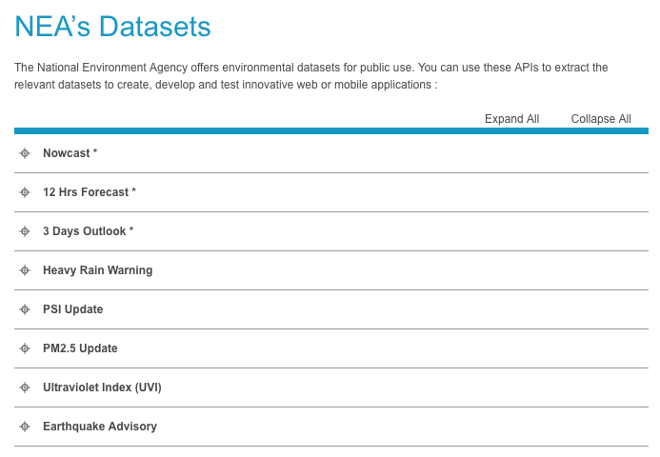
www.nea.gov.sg/api

Slide 10
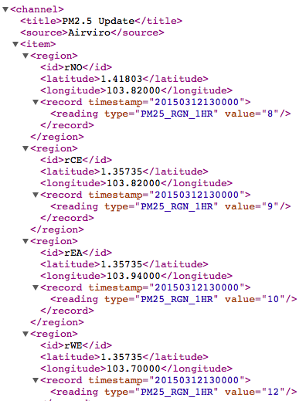
XML

Slide 11
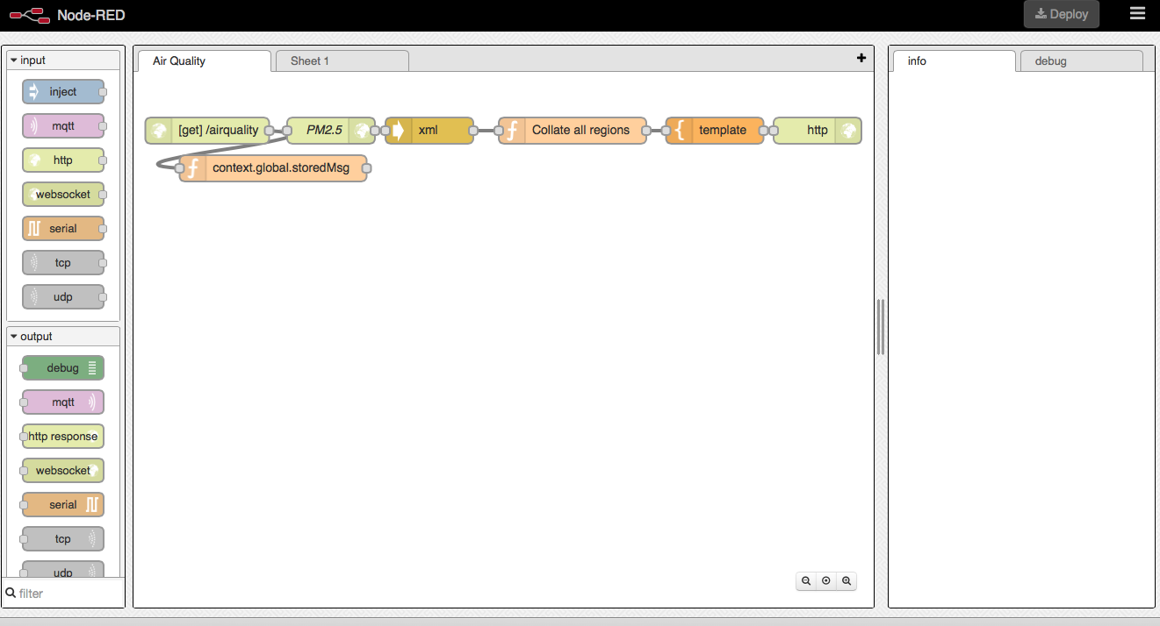
Node Red

Slide 12
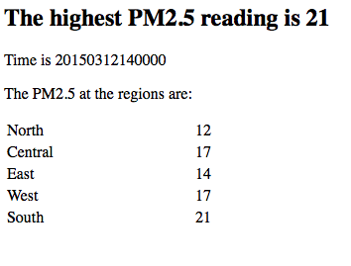

Slide 13
Open society
Honesty & Transparency
Collective ownership
Empowerment
Lower entry barriers & enhanced competitiveness
Innovation
Entrepreneurship

